Slide 1
GGS 650 Project Option 1 Find intersection of US major rivers and US freeways
Jiao Ma
George Mason University

Slide 2
Introduction
Transportation has a pollution for the nearby rivers
find intersection points and intersection segments for major rivers and highways
Revised based on Mini GIS
Tkinter is used to visualization

Slide 3
Introduction
Data Use
US states polygon shapefile
US major rivers polyline shapefile
US freeways polyline shapefile

Slide 4
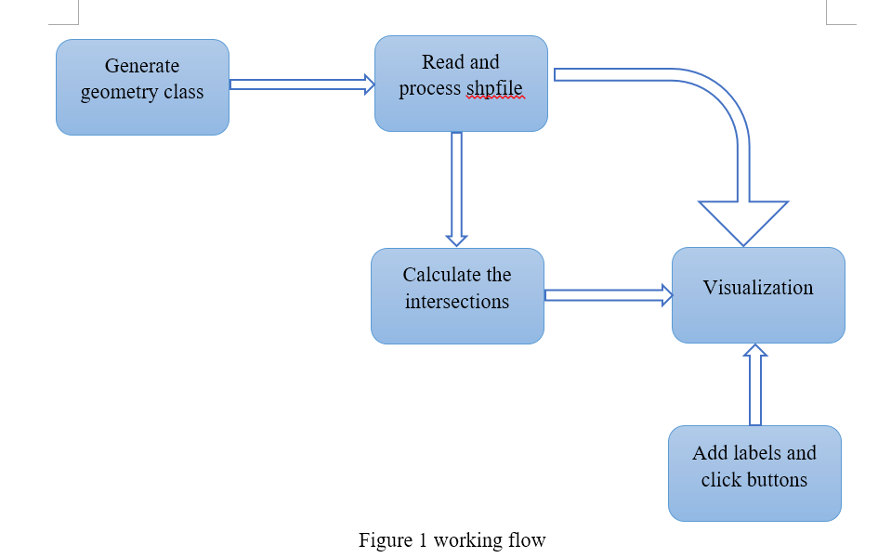
Work Flow

Slide 5
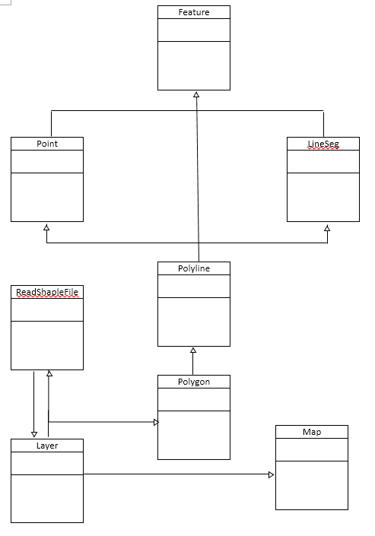
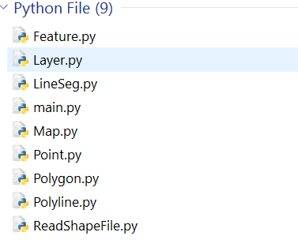
File Composition
nine python files
Except Main file, other files are written
as class

Slide 6
GIS Data Model designed example
Feature
+ none
+ vis(self, map, color): pass + intersect(self, Feature): pass
LineSeg
+ x1: float + y1: float + x2: float + y2: float
+ getLength(self) : Int + bboxcheck(self, lineseg) : Boolean + overlap(self, lineseg): Boolean + intersect(self, lineseg) : Boolean or List
Polyline
+ none
+ getLength(self): float + vis(self, map, color) : draw List + visInterLine(self, map, color): List + bboxcheck(self,polyline): Bollean + intersect(self,polyline): List + intersectLine1(self,polyline): List + intersectLine1(self,polyline): List + transform(self, map): List + findBoundingbox(self): Tuple
Points
+ x: float + y: float
+ distance(self, point): Int + vis(self, map, color) : draw List + transform(self, map): List

Slide 7
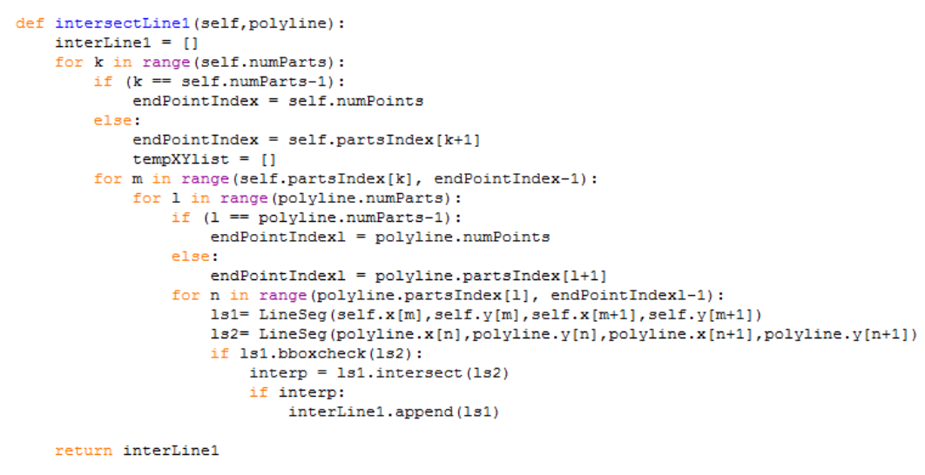
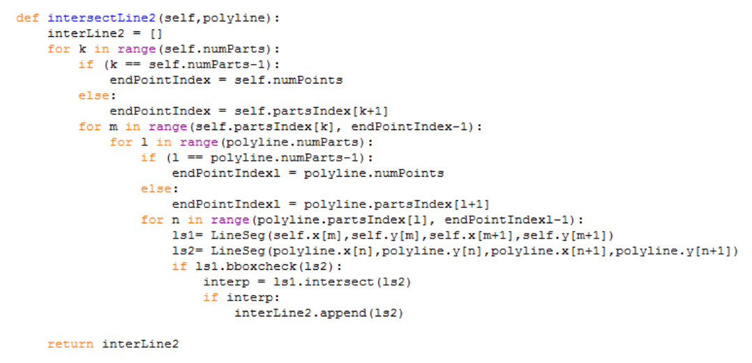
Polyline.py

Slide 8
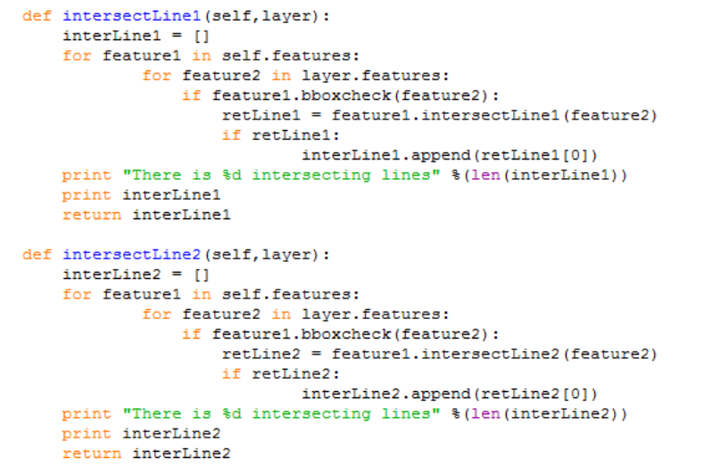
Layer.py

Slide 9
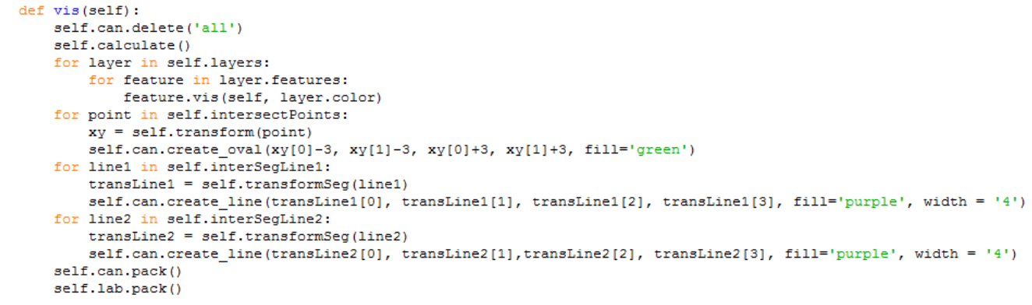
Map.py

Slide 10
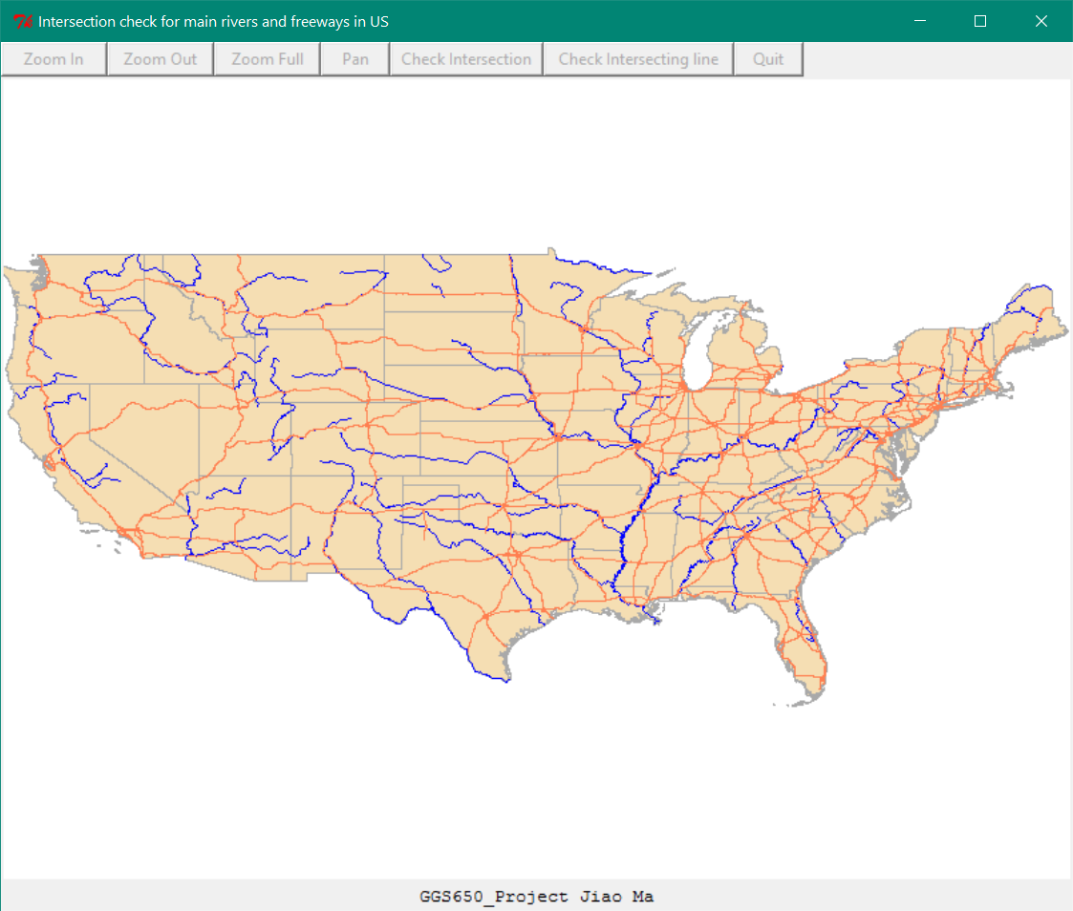
Visualization

Slide 11


Slide 12


Slide 13
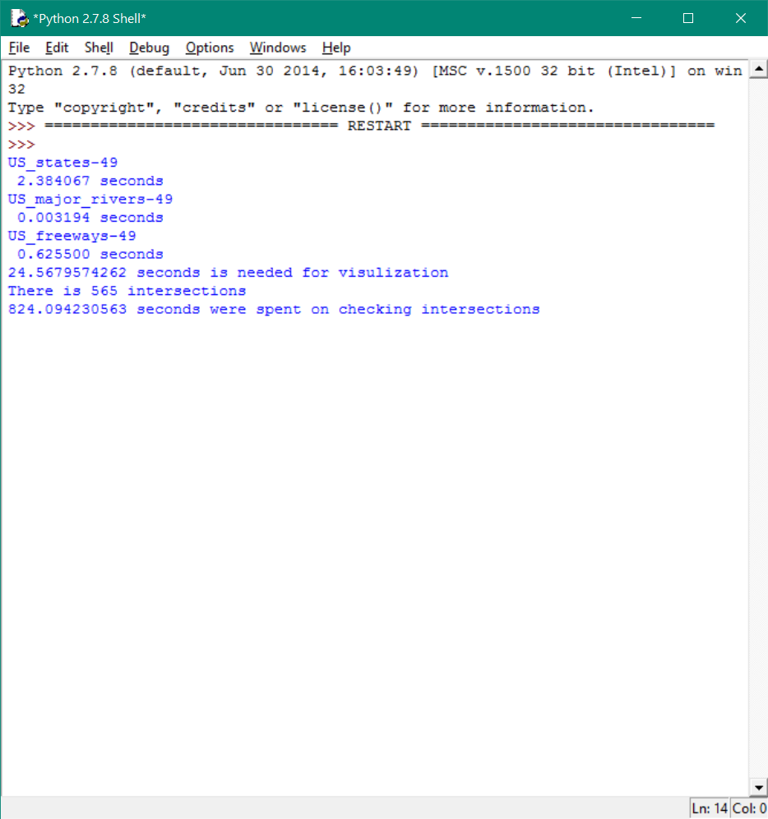
Result

Slide 14
Thank you!

